Slide 1

Equation of States of Nuclear Matter and Tidal deformation of Neutron Stars
by
Nguyen Hoang Dang Khoa
Supervisors:
Prof. Dao Tien Khoa Dr. Ngo Hai Tan

Slide 2


Slide 3
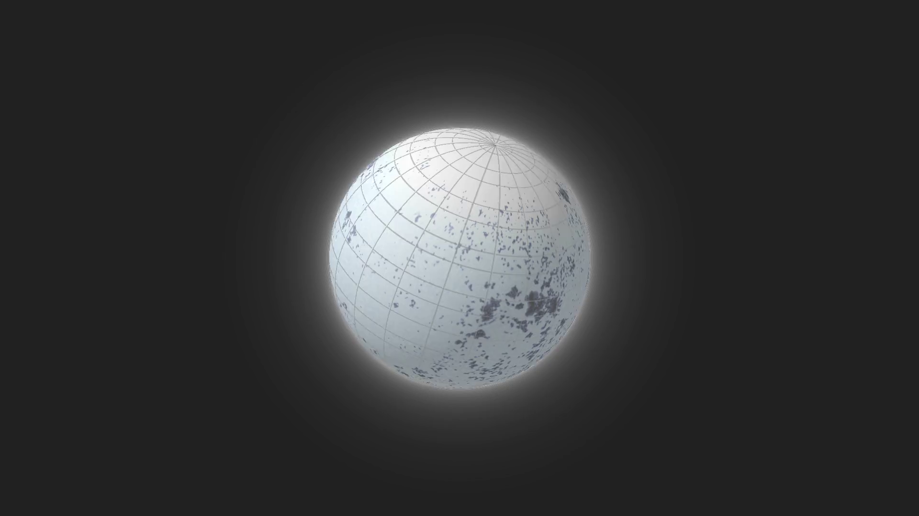


Nuclear Matter and Neutron Star?
1939
TOV equation

Slide 4
Objectives
Inclusion of the spin polarization effects of baryons under strong magnetic field (like in a magnetar) into the Equation of States (EoS) of nuclear matter.
Deducing the relation between Neutron Star’s mass and radius corresponding to each EoS model.
Investigating several types of tidal parameters of a Neutron Star in a binary system and their sensitivity to the EoS.

Slide 5
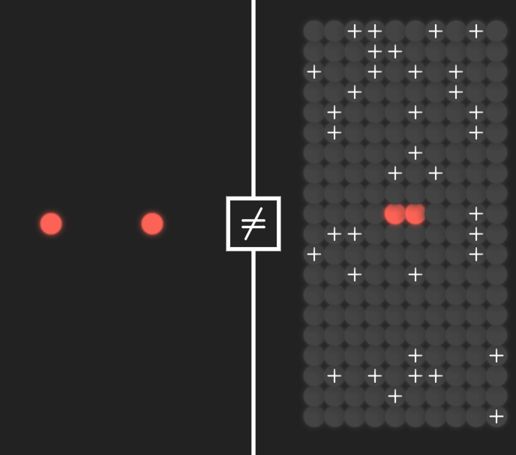
Equation of States of Nuclear Matter Effective interactions
●○○○○
Nucleon-nucleon (NN) interaction in medium is different with that for free NN
Due to the lack of a proper theory in describing nuclear interaction in medium, effective interaction models were adopted, e.g. CDM3Yn

Slide 6
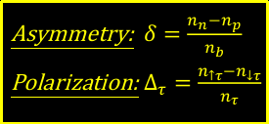


Equation of States of Nuclear Matter CDM3Yn interactions
○●○○○
CDM3Yn interaction has the form
$$v(n_{b}, r)=F_{00}(n_{b})v_{00}(r) + F_{01}(n_{b})v_{01}(r){(σ}_{1}∙σ_{2})$$
$$+F_{10}(n_{b})v_{10}(r){(τ}_{1}∙τ_{2})+F_{11}(n_{b})v_{11}(r){(σ}_{1}∙σ_{2})(τ_{1}∙τ_{2})$$
(1)
someword
The central terms are inherited from M3Y-Paris interaction
Asymmetry: $δ=\frac{n_{n}−n_{p}}{n_{b}}$
Polarization: $∆_{τ}=\frac{n_{↑τ}−n_{↓τ}}{n_{τ}}$
known
$$v_{στ}^{D(EX)}(r)=\sum_{k=1}^{3}{Y_{στ}^{D(EX)}(k)\frac{e^{−μ_{k}r}}{μ_{k}r}}$$
The density-dependent form factors are
$$F_{στ}(n_{b})=C_{στ}[1+α_{στ}e^{−β_{στ}n_{b}}+γ_{στ}n_{b}]$$
to be adjusted

Slide 7
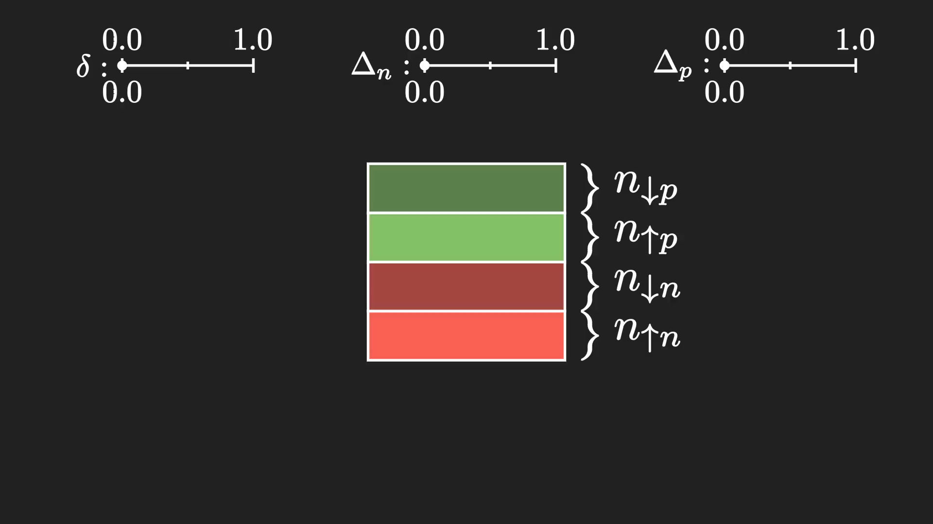

Slide 8

Equation of States of Nuclear Matter Hartree-Fock energy
○○●○○
Total energy of system of nucleons
$$E_{HF}=\sum_{kστ}{\frac{ℏ^{2}k^{2}}{2m_{τ}}}+\frac{1}{2}\sum_{kστ}{\sum_{k’σ’τ’}{\left[\left\langle kστ,k’σ’τ’ | v^{D} | kστ,k’σ’τ’\right\rangle +\left\langle kστ,k’σ’τ’ | v^{EX} | k’στ,kσ’τ’\right\rangle \right]}}$$
(2)
Potential energy
Kinetic energy
Baryonic pressure
$$P_{b}=n_{b}^{2}\frac{∂(E_{HF}/A)}{∂n_{b}}$$
(3)

Slide 9

Equation of States of Nuclear Matter β-stable nuclear matter
○○○●○
Aside from nucleons, leptons ($e^{−}$ and $μ^{−}$) are also included, since
$$n↔p+e^{−}+{\overline{ν}}_{e}$$
$$e^{−}↔μ^{−}+ν_{e}+{\overline{ν}}_{μ}$$
β-stable conditions must be fulfilled
Charge balance
$$n_{p}=n_{e}+n_{μ}$$
(4)
Energy balance
$$μ_{n}−μ_{p}=μ_{e}=μ_{μ}$$
(5)
someword
$$EoS(n_{b},δ,Δ_{n},Δ_{p})↦EoS(n_{b},Δ_{n},Δ_{p})↦EoS(n_{b},Δ)$$

Slide 10
Equation of States of Nuclear Matter Result
○○○○●
Figure 1: EoS of Neutron Star matter corresponding to 4 different nucleon-nucleon interaction models.

Slide 11

Tidal deformation of Neutron Star Neutron Star configuration
●○○○○○○○○
someword
In a highly magnetized Neutron star (a magnetar), the polarization $∆$ is expected to be
high at lower density
reduce to zero at high density
Figure 2: Different scenarios of $Δ(n_{b})$ considered.

Slide 12

Tidal deformation of Neutron Star Tolman-Oppenheimer-Volkoff equation
○●○○○○○○○
The macroscopic properties of neutron star are determined from the equation of states using the TOV equation
$$\frac{dP}{dr}=−\frac{Gρℳ}{r^{2}}\left(1+\frac{P}{ρc^{2}}\right)\left(1+\frac{4πPr^{3}}{c^{2}ℳ}\right){\left(1−\frac{2Gℳ}{c^{2}r}\right)}^{−1}$$
(6)
Mass-Radius M(R)

Slide 13

Tidal deformation of Neutron Star Mass-Radius relation
○○●○○○○○○
someword
Only models with high values of K (CDM3Y6 and CDM3Y8) at partial polarization ($Δ<1$) are plausible
Figure 3: Mass-Radius relation of Neutron Star corresponding with 4 different models and different scenarios concerning the magnetic distribution in the star’s interior.

Slide 14
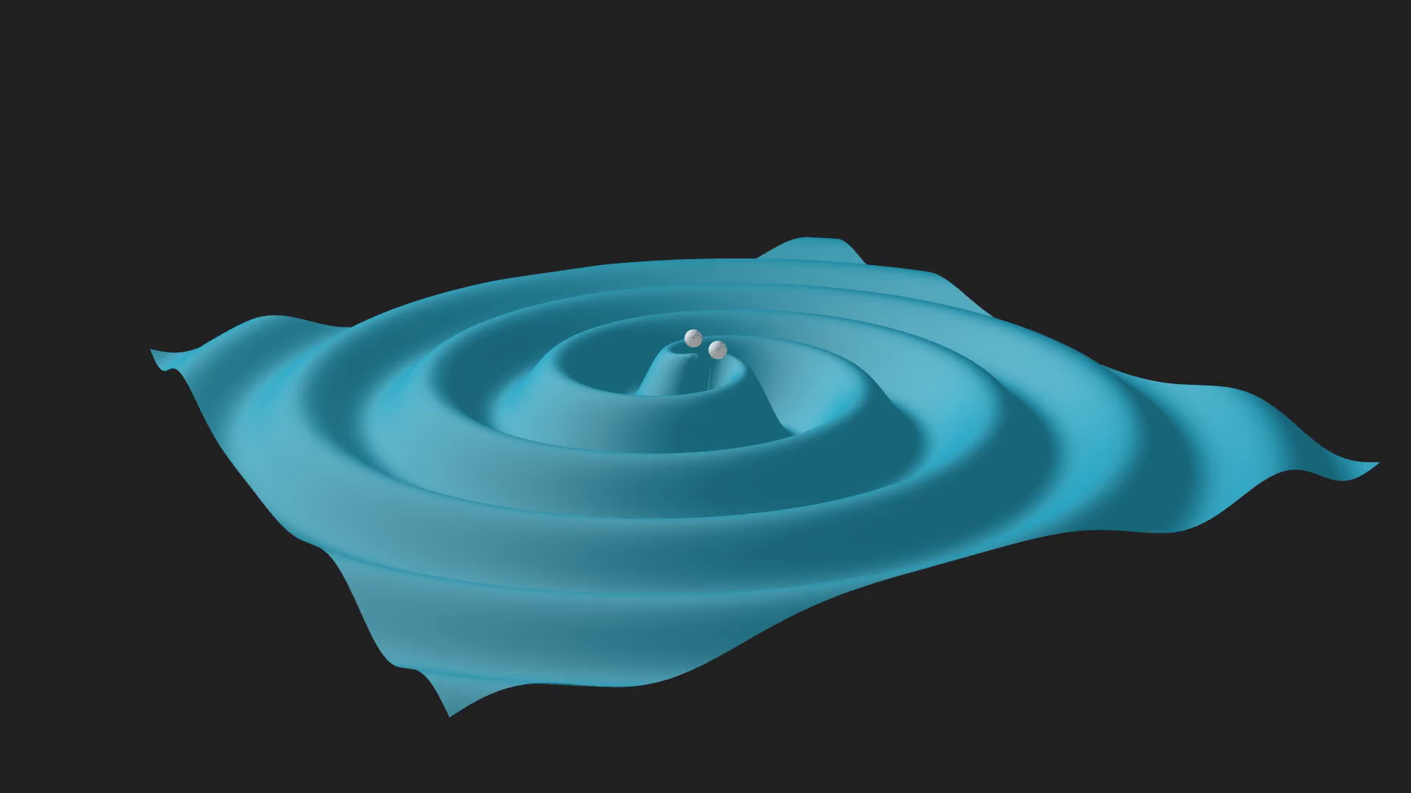
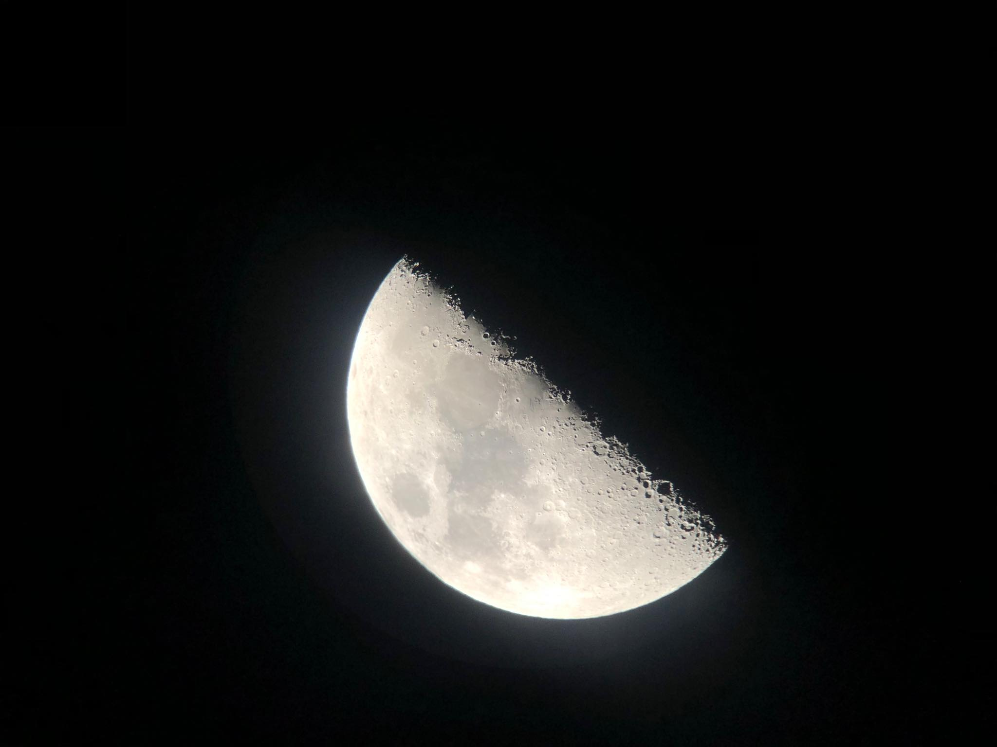
Tidal deformation of Neutron Star Tidal effect in a binary system
○○○●○○○○○
In a binary system of neutron stars, one is subjected to strong tidal effect caused by the other

Slide 15
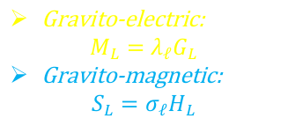
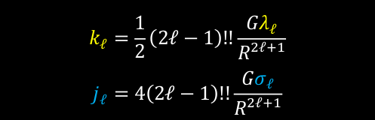
Tidal deformation of Neutron Star Tidal Love numbers
○○○○●○○○○
The tidal properties of a neutron star are expressed in order $ℓ$ as
Tidal field strength
Gravito-electric:
$$M_{L}=λ_{ℓ}G_{L}$$
Gravito-magnetic:
$$S_{L}=σ_{ℓ}H_{L}$$
Body’s reaction
(7)
someword
someword
Equivalently, they can also be described by the tidal Love numbers of order $ℓ$
$$k_{ℓ}=\frac{1}{2}\left(2ℓ−1\right)!!\frac{Gλ_{ℓ}}{R^{2ℓ+1}}$$
$$j_{ℓ}=4\left(2ℓ−1\right)!!\frac{Gσ_{ℓ}}{R^{2ℓ+1}}$$
(8)

Slide 16
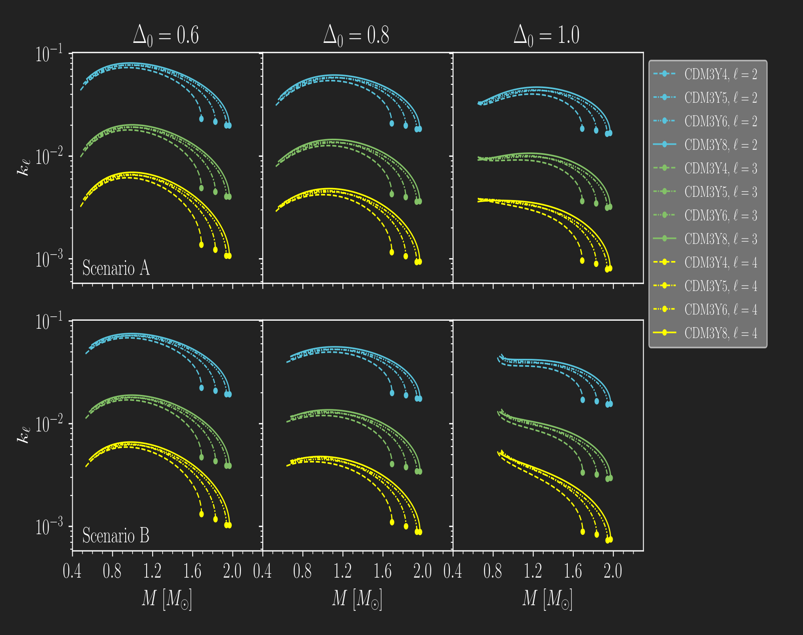
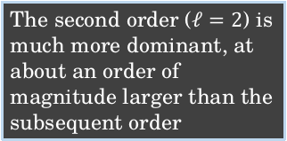
Tidal deformation of Neutron Star Tidal Love numbers
○○○○○●○○○
someword
The second order ($ℓ=2$) is much more dominant, at about an order of magnitude larger than the subsequent order
Figure 4: Gravito-electric tidal Love numbers up to 4th order.

Slide 17

Tidal deformation of Neutron Star Dimensionless tidal parameter
$$Λ_{2}=\frac{2}{3}k_{2}{\left(\frac{c^{2}R}{GM}\right)}^{5}$$
○○○○○○●○○
Figure 5: Gravito-electric dimensionless tidal parameter of 2nd order.

Slide 18
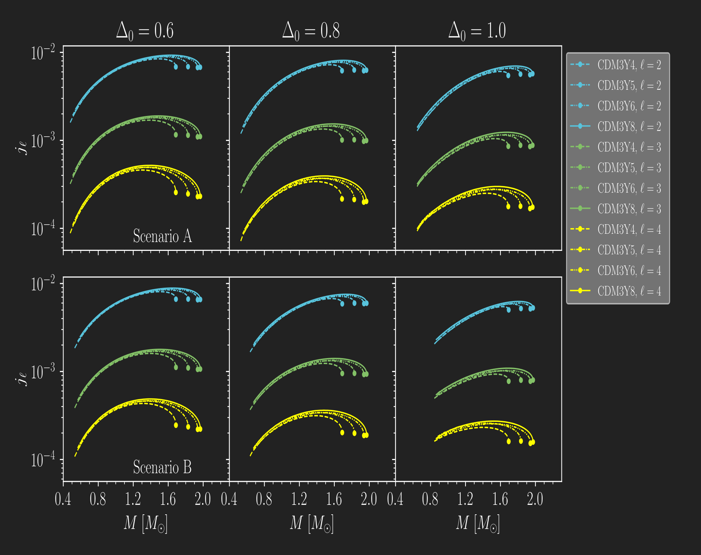
Tidal deformation of Neutron Star Tidal Love numbers
○○○○○○○●○
Static fluid
The same trend is found in gravito-magnetic Love numbers. However, they appear to be 1 order of magnitude lower than their GE counterparts.
Figure 6: Gravito-magnetic tidal Love numbers up to 4th order for the case of static fluid.

Slide 19
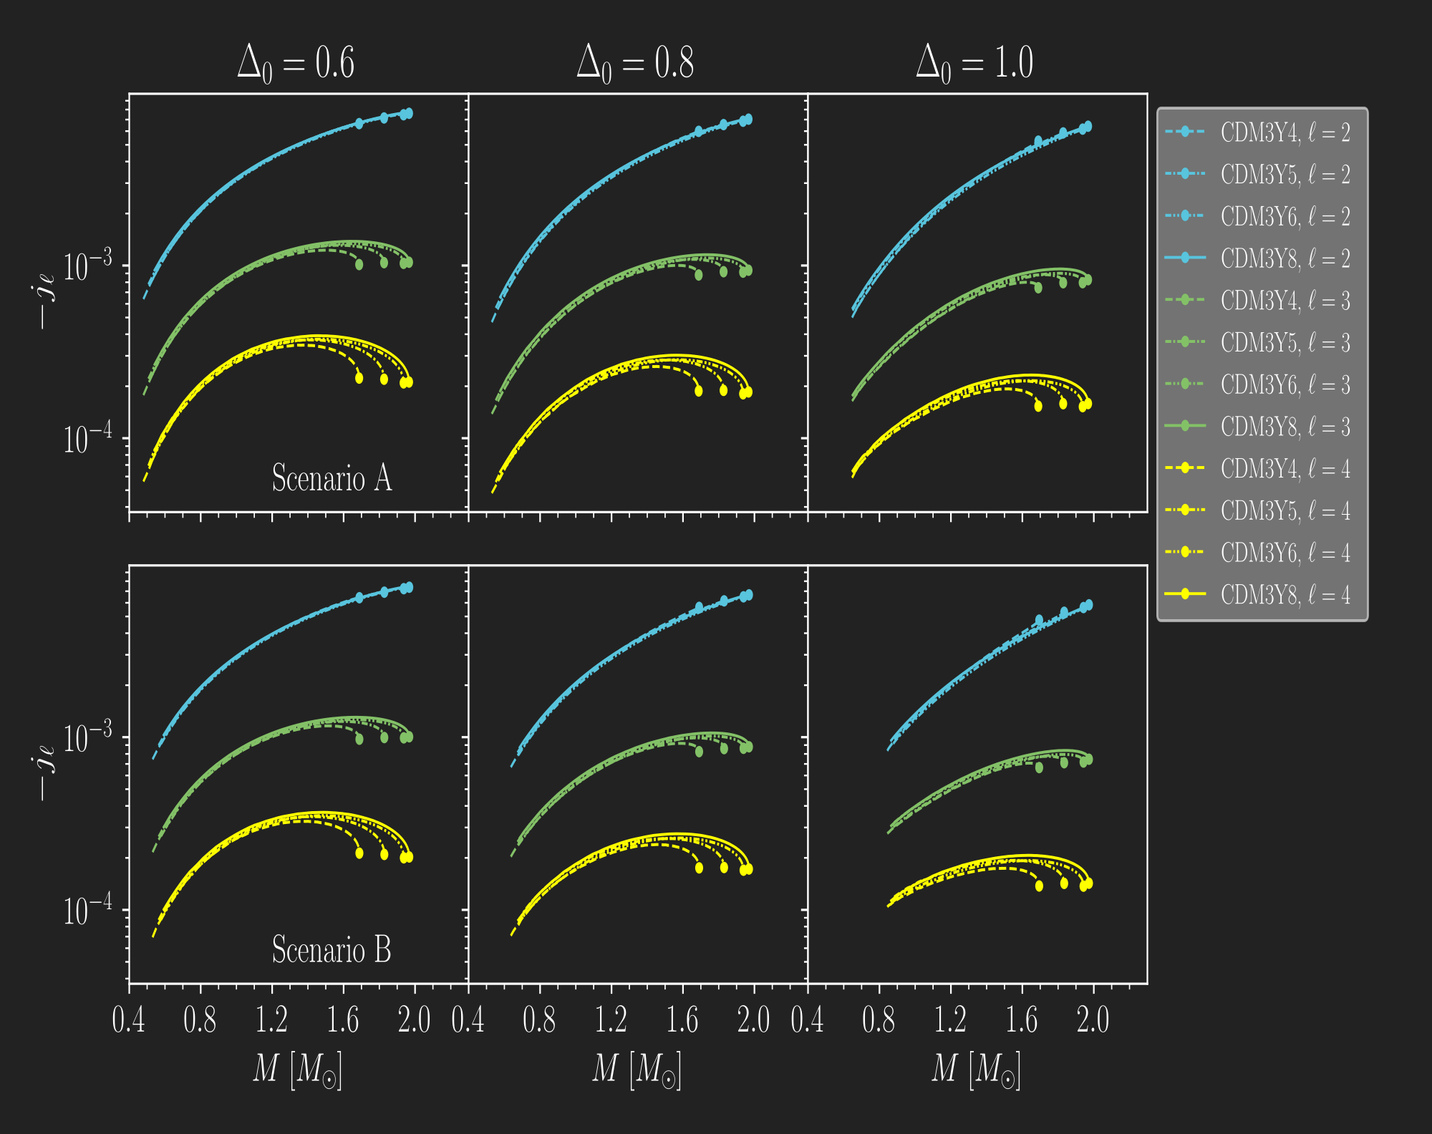
Tidal deformation of Neutron Star Tidal Love numbers
○○○○○○○○●
Irrotational fluid
Figure 6: Gravito-magnetic tidal Love numbers up to 4th order for the case of irrotational fluid.

Slide 20

Conclusions
The case of total polarization at the outer core and crust is ruled out as expected.
Higher values of K are favored as only CDM3Y6 and CDM3Y8 come close to the lower mass limit of the heaviest pulsars observed.
The tidal properties of the neutron star are also investigated with assumptions and up to fourth order in contribution, which returns a close result with those obtained in recent study.
Perspective:
Accurately calculate the density-dependence of the polarization $Δ$,
Extending to a model of hot β-stable nuclear matter ($T>0 K$),
Describing the recently found evidence of the quark-matter core in the interior of massive Neutron Stars.
someword

Slide 21
Thank you for your attention!

